Slide 1
Rag Chatbot- Medquad Dataset
Using ChromaDB + Gemma 3
Apoorv Gupta | May 2026

Slide 2
Process / Timeline
01
02
03
04
Research
Cleaning
Build
Deploy
Gather data and insights
Clean erroneous entries
Perform embedding and load in ChromaDB
Pass the response to LLM and send to frontend

Slide 3
SECTION
About the Data
Dataset compostition
Feature distrubution

Slide 4
Dataset Composition
95%
2.4K
18ms
4.9
Question
Answer
Source
Focus Area

Slide 5
Feature Distribution – Focus Area
Unique Focus Areas
Entries Per Focus Area
No. of Focus Area with 1 question
Out of 16412 questions, Total number of unique focus areas: 5125
Entries per Focus Area:
- Maximum: 53
- Average: 3.20
- Minimum: 1
Number of focus areas with only 1 question: 2332
This represents 45.50% of all unique focus areas.

Slide 6
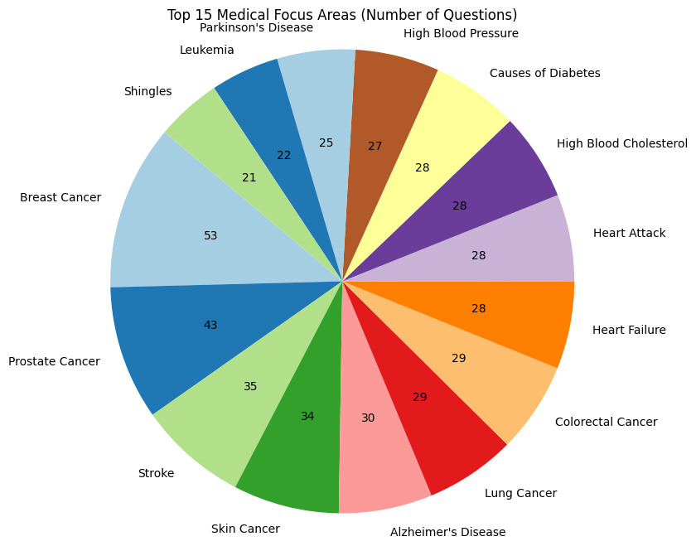
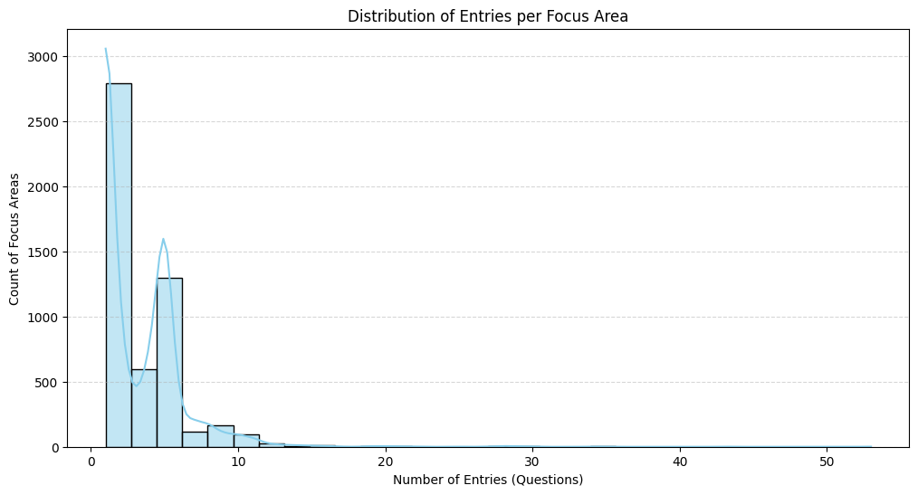
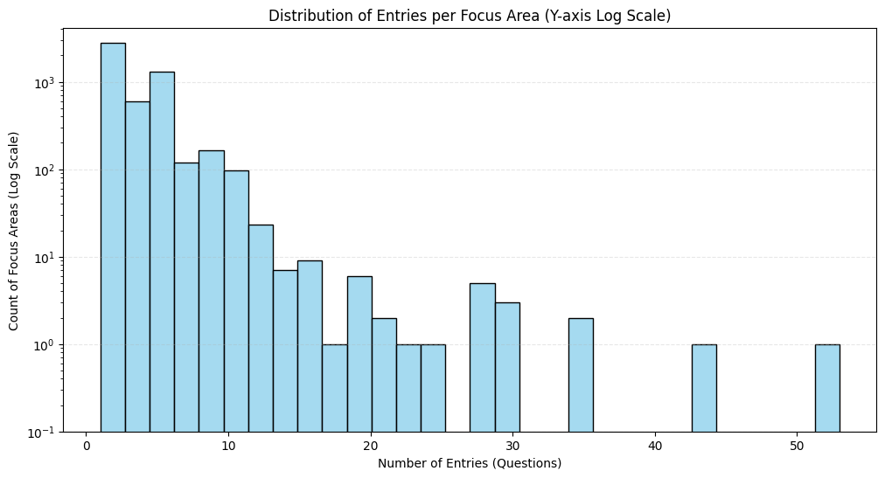
Feature Distribution – Focus Area
Unique Focus Areas
Entries Per Focus Area
No. of Focus Area with 1 question
Out of 16412 questions, Total number of unique focus areas: 5125
Entries per Focus Area:
- Maximum: 53
- Average: 3.20
- Minimum: 1
Number of focus areas with only 1 question: 2332
This represents 45.50% of all unique focus areas.

Slide 7
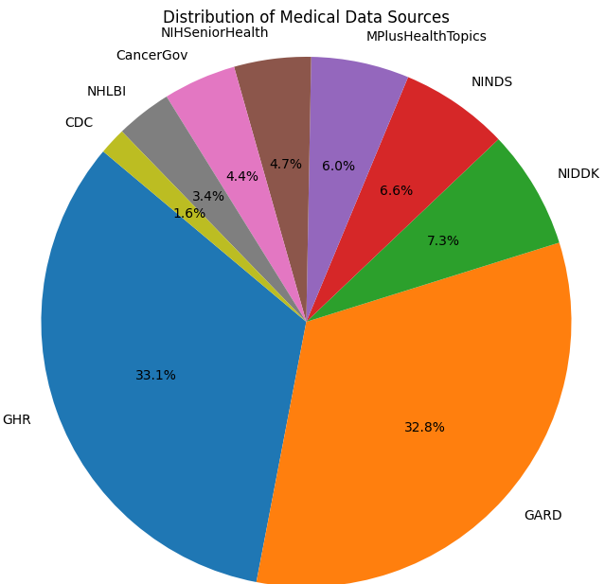
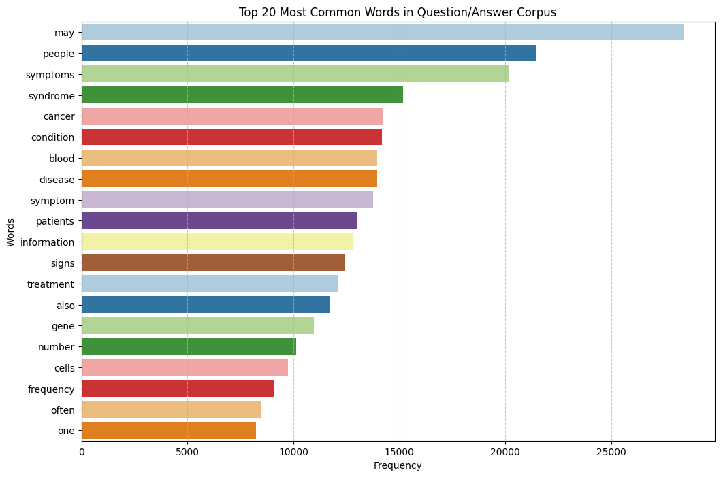
Feature Distribution
Distribution of Data Sources
Top 20 common words in the Question/Answer Corpus
First bullet point goes here
Supporting detail one

Slide 8
SECTION
Cleaning

Slide 9
SECTION
RAG System

Slide 10
Process / Timeline
01
02
03
04
Research
Build
Retreival
Saving
Gather types of embeddings possible and choose the best one
Perform embedding via all-MiniLM-L6-v2 and load in ChromaDB
Return top docs via Cosine Similarity
Save the embeddings for faster future use

Slide 11
Embedding Research
Sparse Embeddings
Word Embeddings
Sentence / Paragraph Embeddings
TF-IDF
Bag of Words
Word2Vec: Predicts context words. Two variants:
CBOW (context → word)
Skip-gram (word → context)
GloVe: Uses global word co-occurrence statistics. More “statistical” than Word2Vec
FastText: Breaks words into subwords. Handles rare + misspelled words better
Whole sentence → one vector
Examples:
Sentence-BERT
all-MiniLM-L6-v2
all-mpnet-base-v2
Used in:
semantic search
RAG
clustering
Based on keyword search
Cannot understand semantic meanings
Not suitable for chatbots where user may not enter exact words.
Each word has one fixed vector (no context awareness)

Slide 12
All about all-MiniLM-L6-v2
Training
About
Performance
Sentence embedding model (SBERT family)
Base: BERT (MiniLM distilled)
~5× faster than large models
Strong semantic similarity, lower than MPNet
Specs
Pipeline
Layers: 6 Params: ~22M Embedding size: 384 Max tokens: ~256 Model size: ~22MB
Text → Tokens → 6-layer Transformer → Mean Pool → 384-d vector
Uses
Training
Semantic search (RAG)
Clustering, similarity
Data: ~1B sentence pairs
Method: Contrastive learning

Slide 13
All about all-MiniLM-L6-v2
Sparse Embeddings
Word Embeddings
Sentence / Paragraph Embeddings
TF-IDF
Bag of Words
Word2Vec: Predicts context words. Two variants:
CBOW (context → word)
Skip-gram (word → context)
GloVe: Uses global word co-occurrence statistics. More “statistical” than Word2Vec
FastText: Breaks words into subwords. Handles rare + misspelled words better
Whole sentence → one vector
Examples:
Sentence-BERT
all-MiniLM-L6-v2
all-mpnet-base-v2
Used in:
semantic search
RAG
clustering
Based on keyword search
Cannot understand semantic meanings
Not suitable for chatbots where user may not enter exact words.
Each word has one fixed vector (no context awareness)

Slide 14
“
all-MiniLM-L6-v2 delivers strong semantic understanding while remaining fast and lightweight.
Unlike sparse methods like TF-IDF, it captures meaning rather than exact keywords, enabling better matching of symptoms and queries. Compared to larger embedding models, it offers near-competitive accuracy with significantly lower latency and compute cost, making it suitable for real-time responses. This balance of speed, efficiency, and semantic performance makes it more practical than heavier models and more intelligent than traditional techniques for medical information retrieval.

Slide 15
SECTION
Passing information to LLM

Slide 16
SECTION
Response Evaluation
Retrieval Metrics
Hit Rate @ 5: 100%
Mean Reciprocal Rank (MRR): 98.8%
Generation Evaluation
LLM as a judge (using smarter LLM with strict instructions)

Slide 17
Thank You!
Questions? Let's discuss.
apoorvgupta479@example.com | github.com/apoorvgupt479 | linkedin.com/apoorv---gupta

